Slide 1
March 14, 2022

Slide 2

Components Inside & Out
Presented by: Michael Hanson, Software Trainer

Slide 3
Agenda
What are components?
  Purpose and Examples
Using Components
  Editors
Building Components
  Level 10 Administrators
Workshop
  Basic – Blockquote
  Intermediate – Hero Banner
  Advanced – Flexible Menu
Special Considerations

Slide 4
What are Components?
Reusable Content in Omni CMS
  Managed in Content Tab -> Components (Level 10)
Allows complex web designs, layouts, and patterns to be defined once and used in many places
Many common and unique use cases
  Blockquotes
  Image with Caption
  Banners
  Styled Buttons
  Testimonial Sections
  Etc…

Slide 5
Why Components?
Alternative to Snippets
  Form Fields vs. Snippet Table Transformations
Updates to code base applied to every component already in use
Single location for code base
Clean interface for managing form elements and source code
Level 10 access only (for creating/editing)
  Editors can use components
Optional - Can preview actual output while editing in WYSIWYG (unlike snippets/assets)

Slide 6
Let’s look at some component examples!

Slide 7
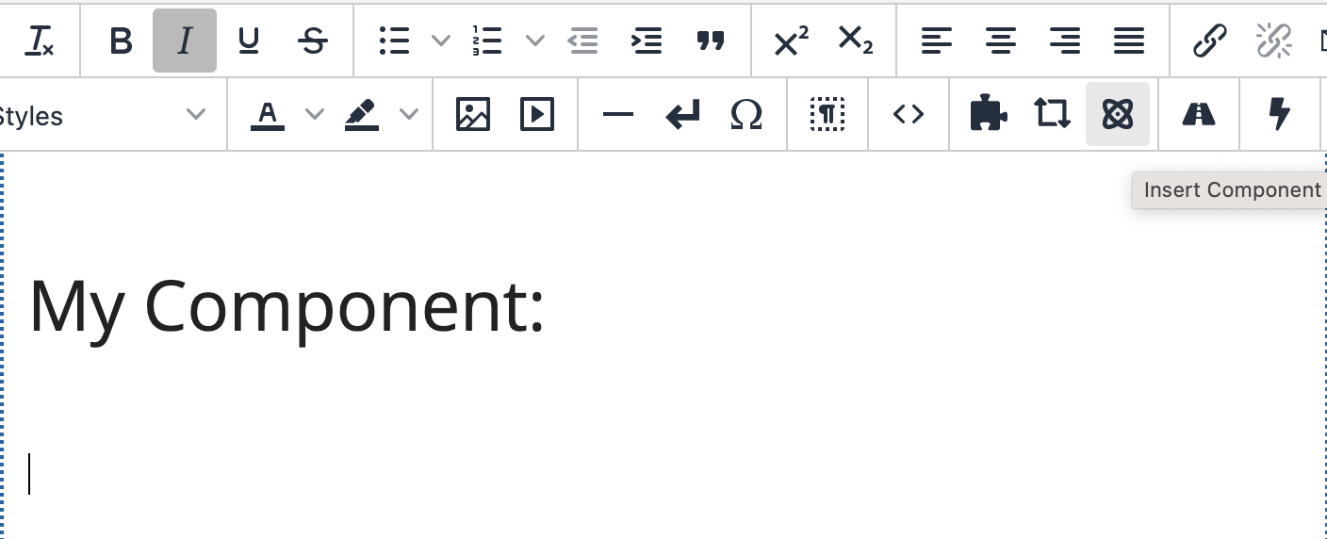
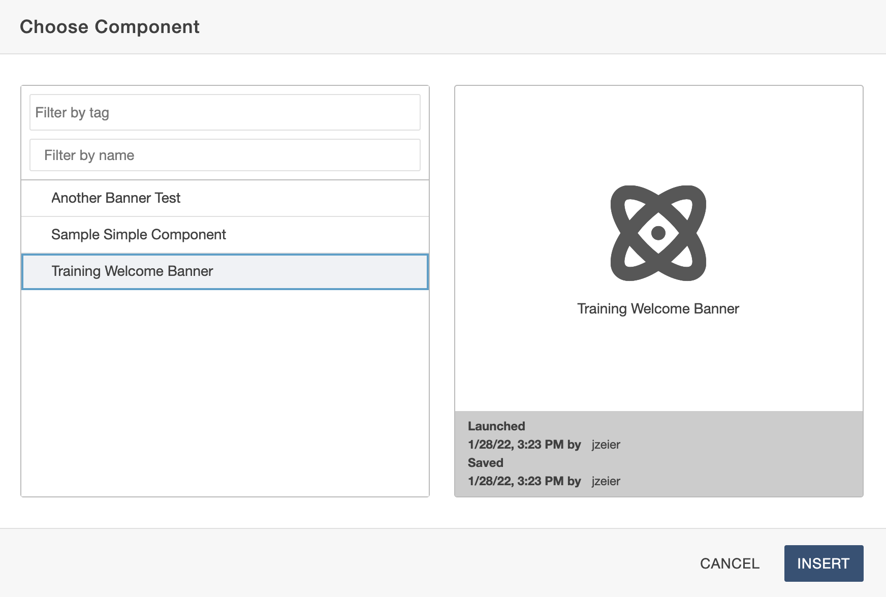
Inserting/Using Components
Editors can insert instances of any existing component from toolbar
In toolbar, look for component 'atomic' symbol
Insert Component Menu
  Lists all available components
  Can filter by tag or name
  Launched/Saved Date

Slide 8
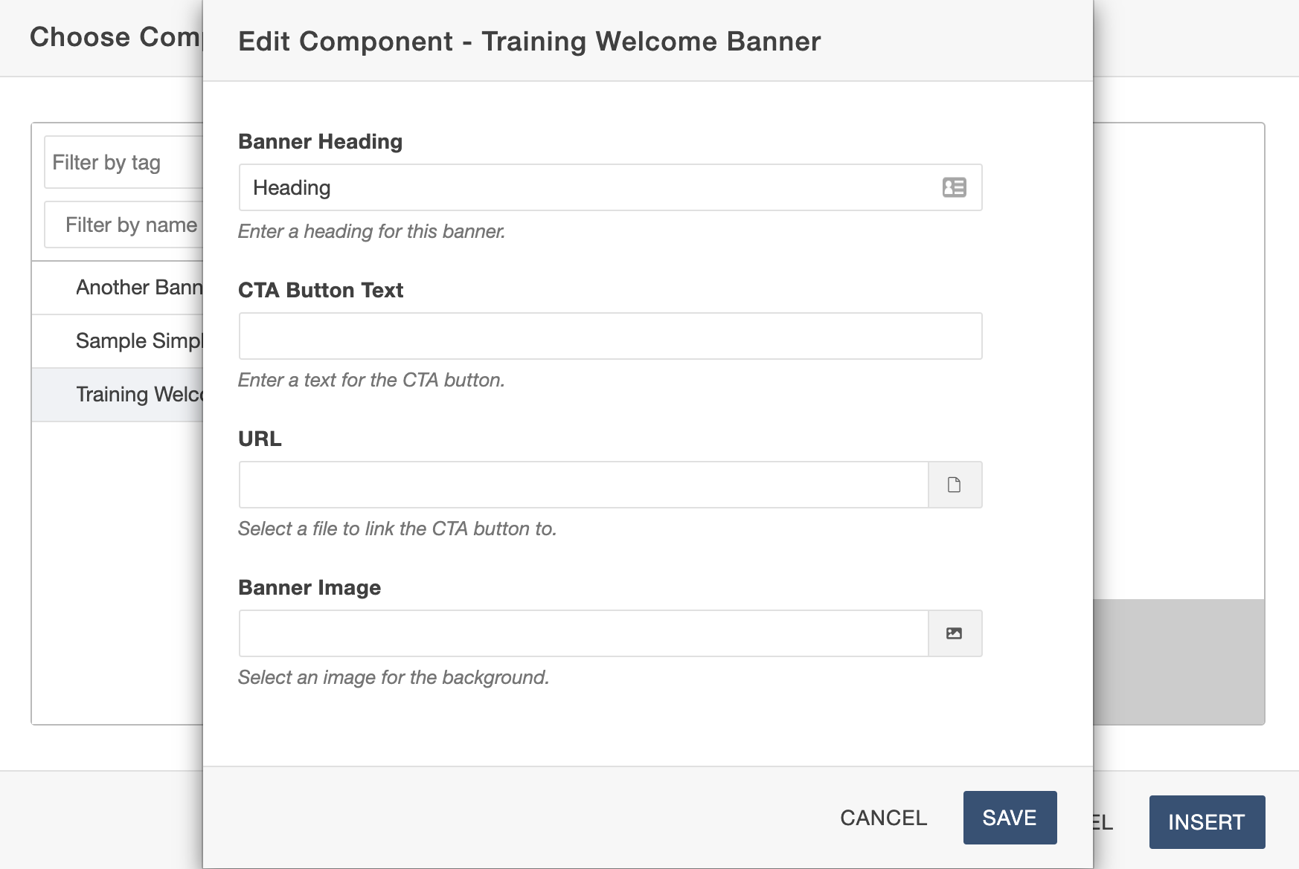
Inserting/Using Components
You will be prompted via form fields to insert values into component elements.
Optional vs. Required Fields
  Some fields will say (required)
  Component can only be inserted with a value filled in to required fields
Different Form Elements
  Elements can be as simple as short/long text or as complex as image/file choosers to select a file from Omni CMS

Slide 9
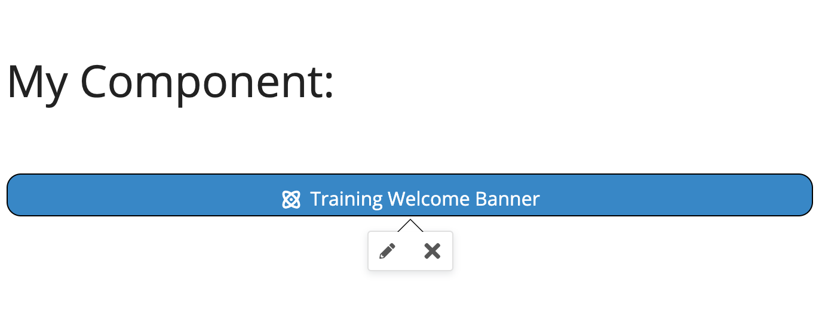
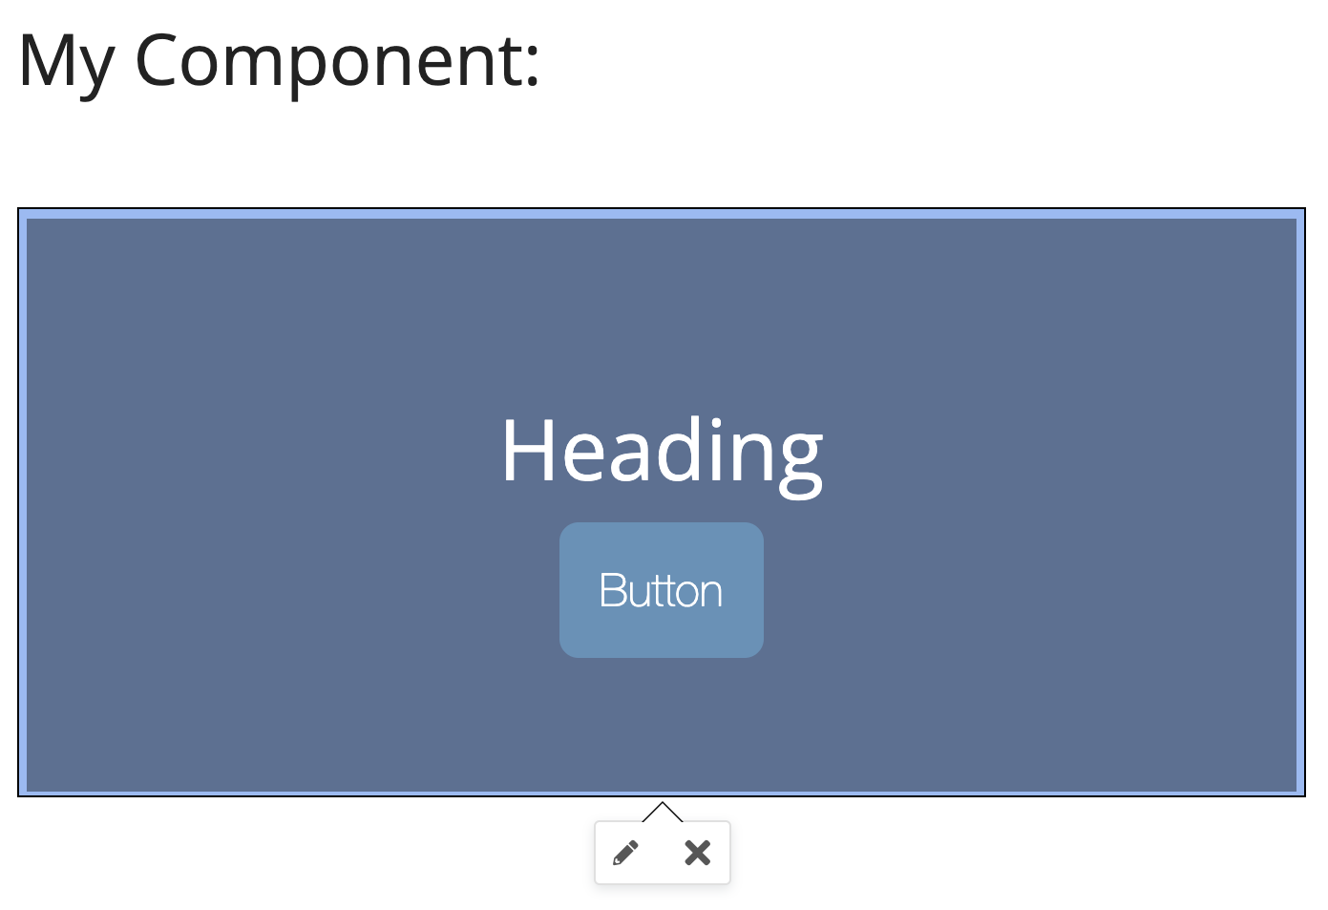
Inserting/Using Components
Once inserted, it will appear as a 'blue pill' or preview (if preview is turned on)
Click component pill/preview to edit (pencil icon) or delete (x icon) while in WYSIWYG

Slide 10
Let’s see how to build components!

Slide 11
Note on Completing Challenges
In your Evolve 2022 Sandbox, find the folder "components-inside-and-out"
  This is where all pages are located, including pages with samples as well as components.pcf where you will place your components.
  There is a file called components-completed.pcf which shows the solutions with completed versions.
Go to Content -> Components
  This is where all "Starter" component files are, as well as SOLUTION components and other samples.

Slide 12
Note on Completing Challenges
A copy of these slides are located in /components-inside-and-out/powerpoint-slides
Instructions for completing these tasks are located in /components-inside-and-out/challenges
Each challenge has a corresponding "Starter" component to copy as well as a SOLUTION component to look at as reference.
Do not modify components that say "Do Not Modify"

Slide 13
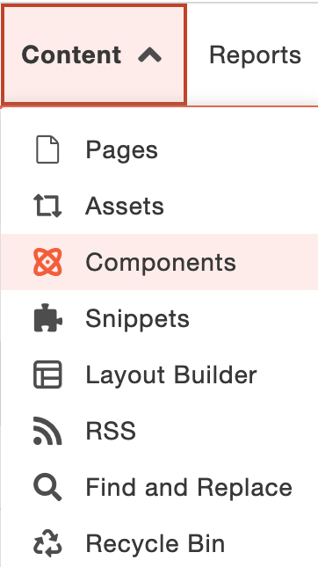
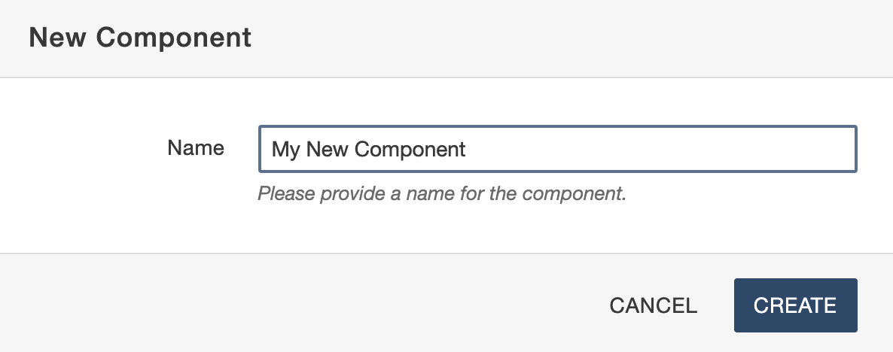
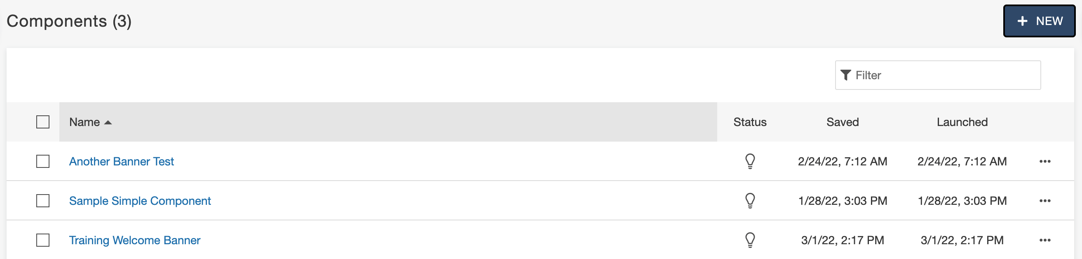
Creating/Editing Components
Level 10 Admin
  Select Content -> Components
Press + New
Provide name of new component
Copying Components
  More Actions (…) -> FILE -> Copy
  Give Unique Name

Slide 14
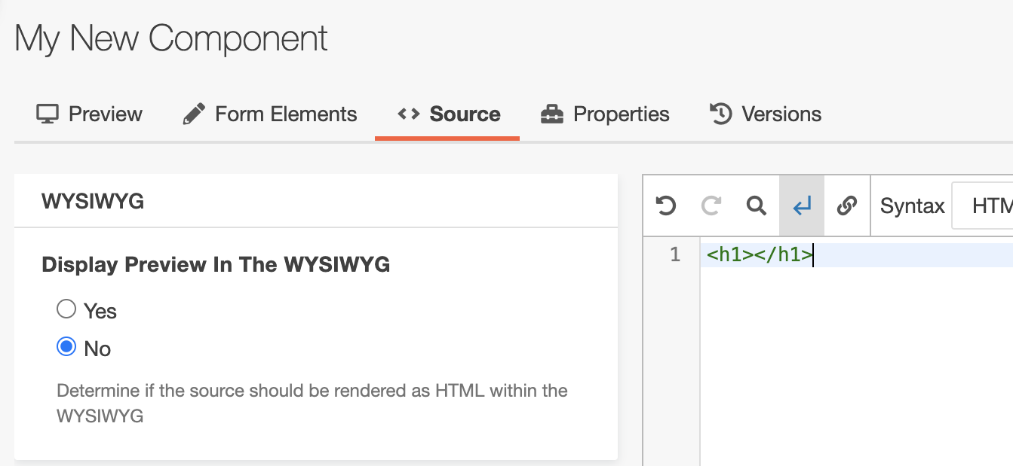
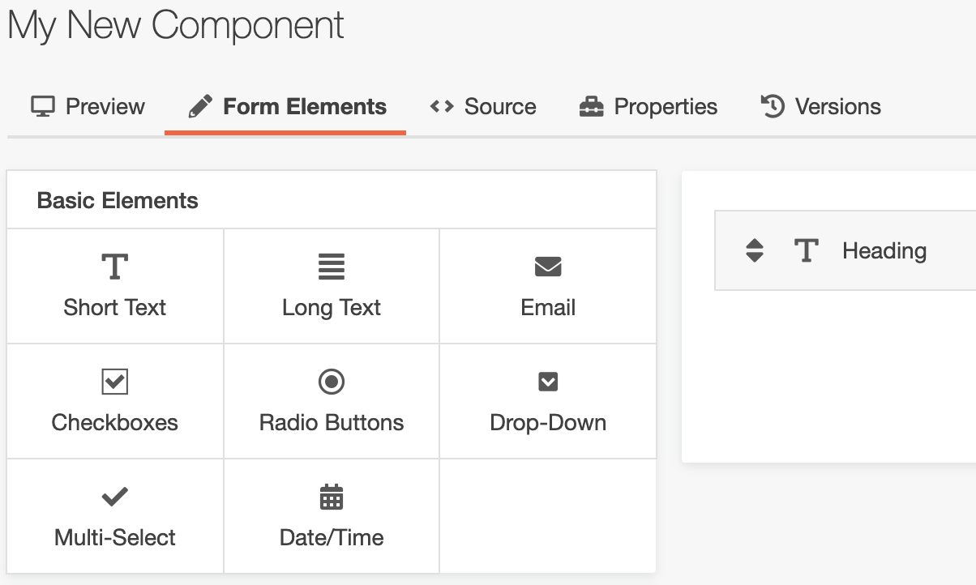
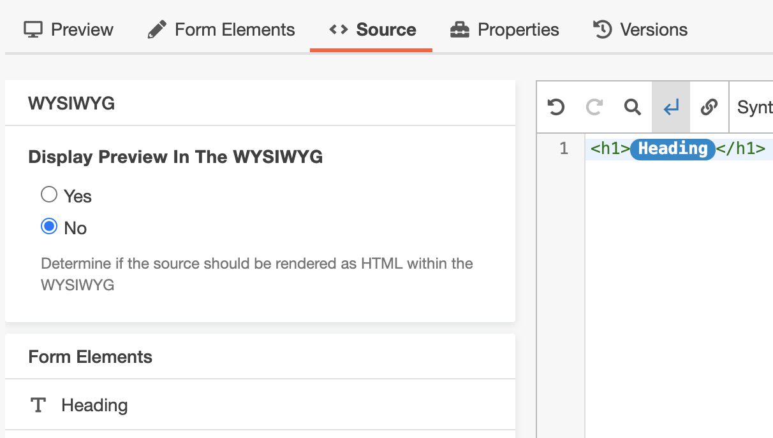
Creating/Editing
Components
Page Actions Toolbar
  Similar structure to pcf pages
Source Tab
  Paste code for web content
  This serves as the component 'skeleton'
  Remove parts of code we want customizable by the user
Form Elements Tab
  Select element types
  Used to collect user input
  'Plugged into' source code

Slide 15
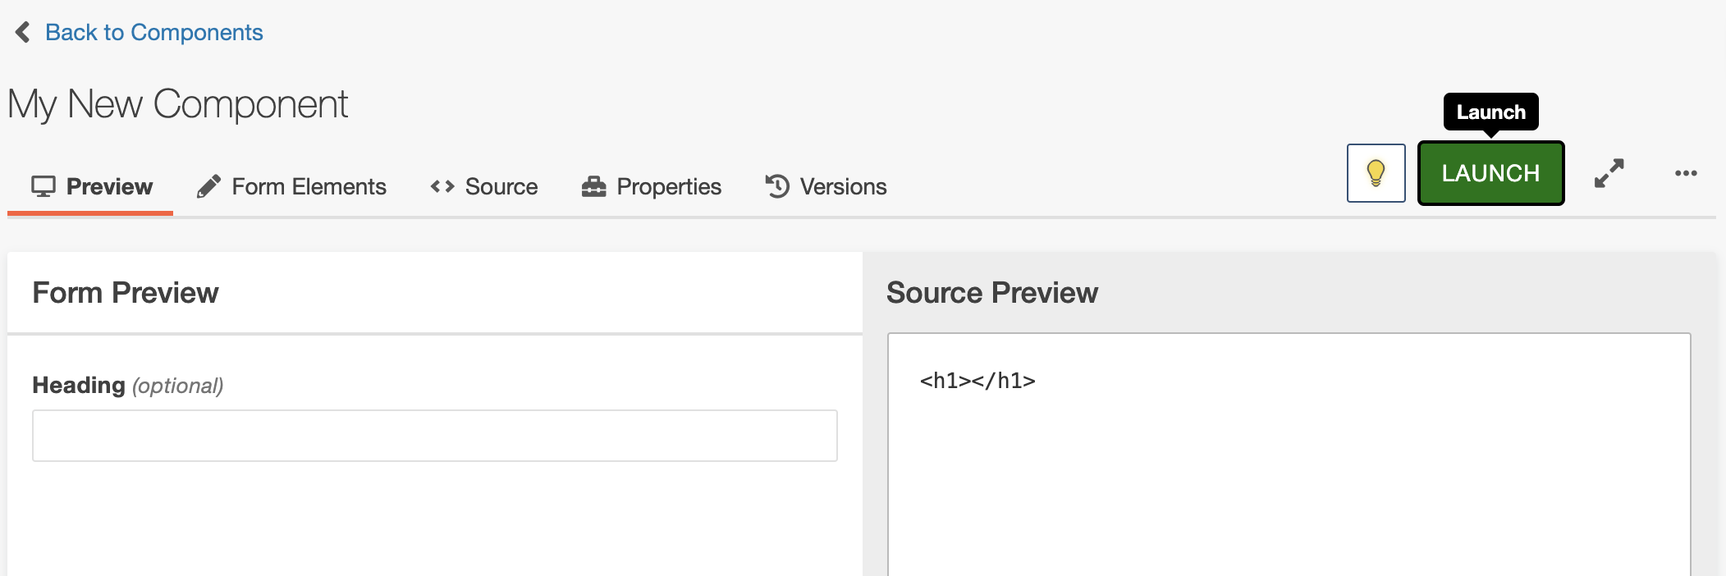
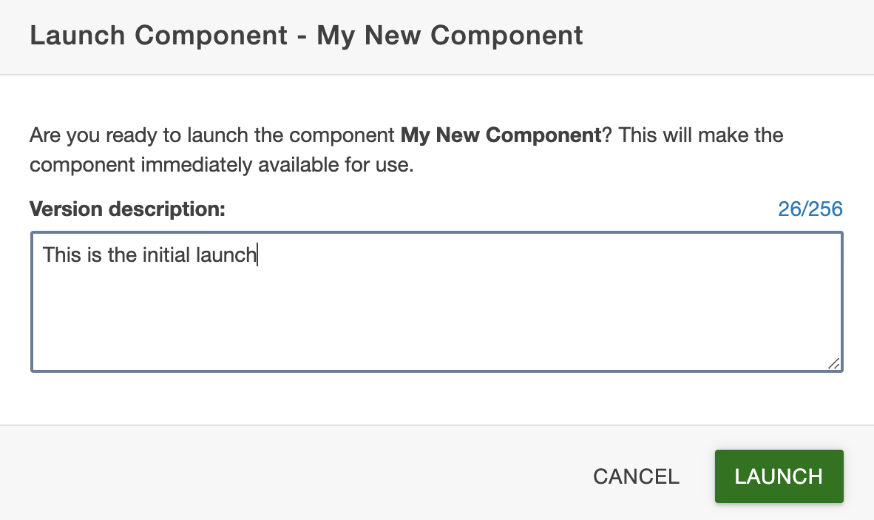
Creating/Editing Components
Once you are finished, save your work.
To make component available to editors, click LAUNCH.
Write a version description for versions tab.

Slide 16
Exercises

Slide 17
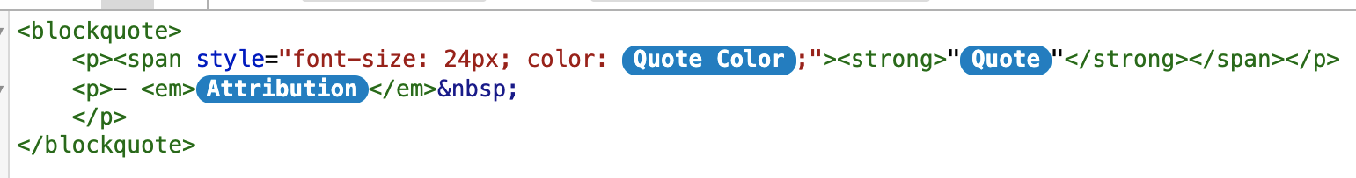
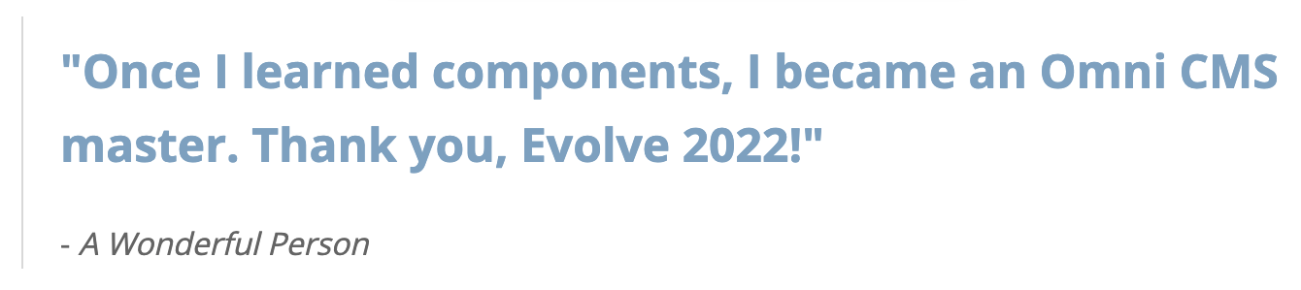
Exercise #1:
Basic Component
(Blockquote)
Renders a simple large quote (blue or gray) with an attribution/author.
Elements Used:
  Short Text
  Radio Button (Uses Advanced Tab to define color values)
Instructions located in the challenges folder (challenge1.txt)

Slide 18
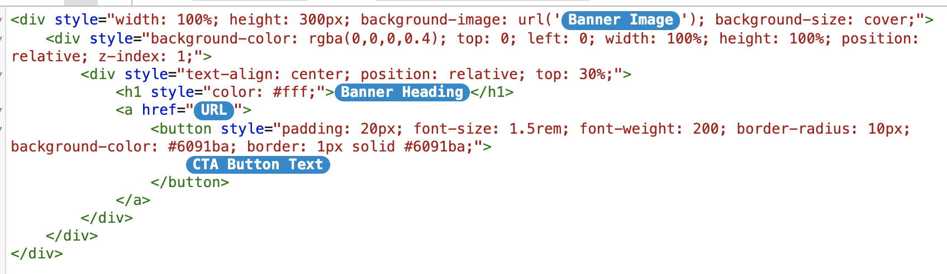

Exercise #2:
Intermediate Component
(Hero Banner)
Renders a full-width image (with dark overlay) of fixed height with a heading and Call-to-Action (CTA) button.
Elements Used:
  Short Text
  File Chooser
  Image Chooser
Instructions located in the challenges folder (challenge2.txt)

Slide 19
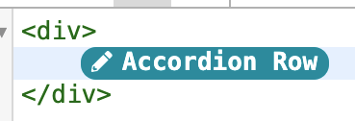
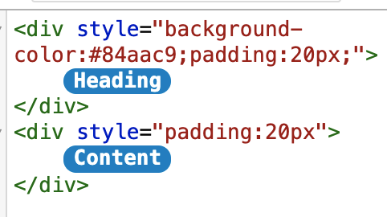
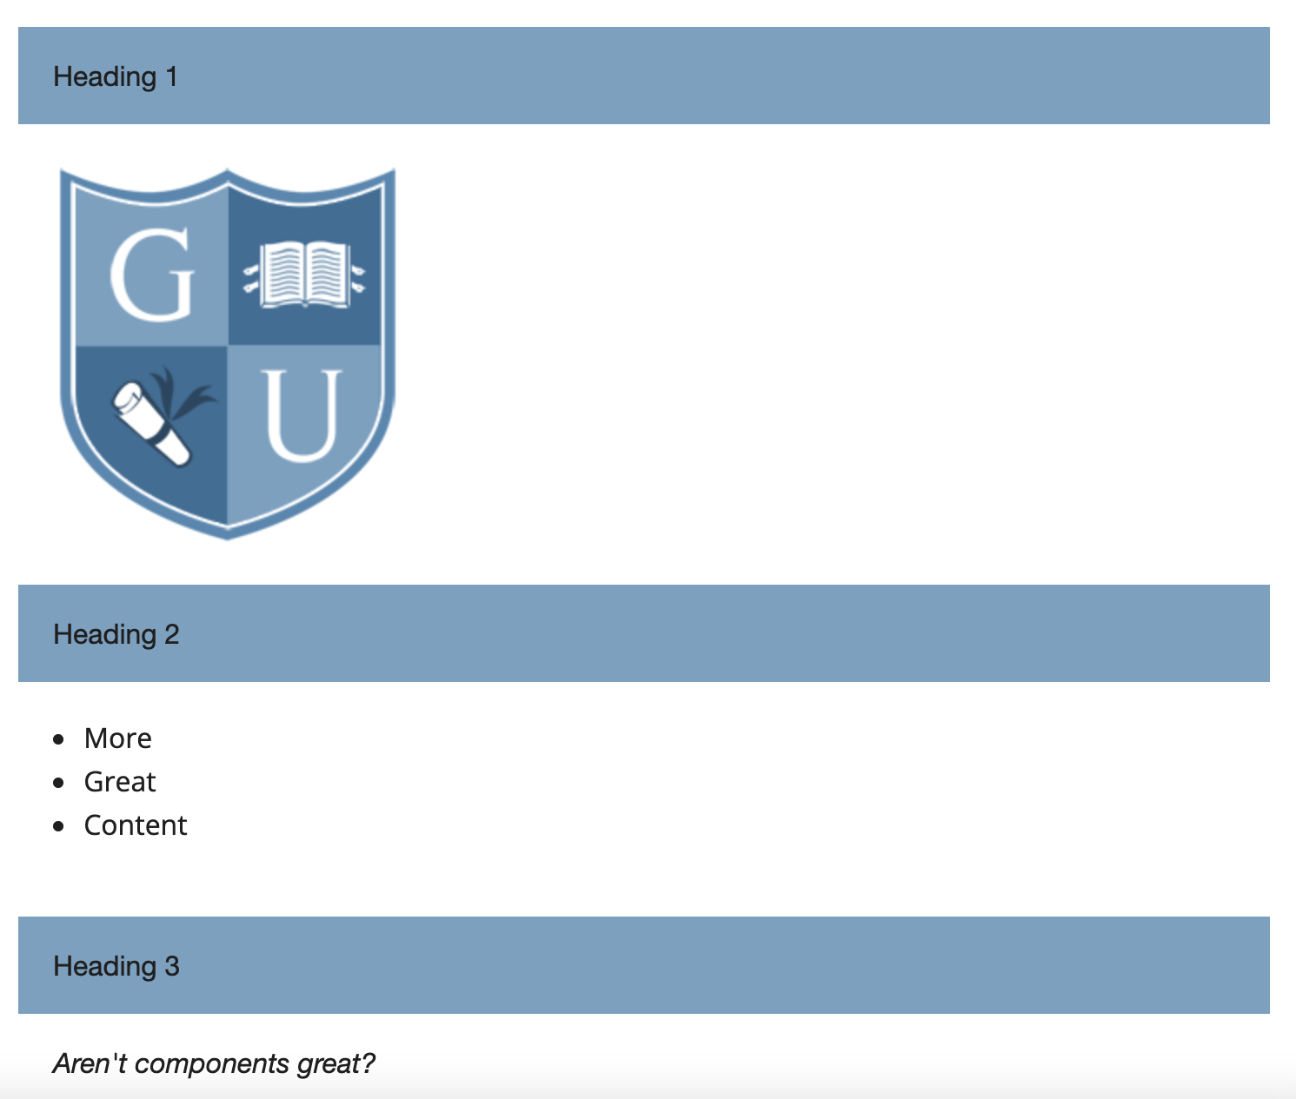
Exercise #3:
Advanced Component
(Flexible Menu)
Renders a list of any number of items, containing a heading and content section for each.
Elements Used:
  Structural Group (used to group other elements)
  Short Text
  WYSIWYG Editor
Instructions located in the challenges folder (challenge3.txt)

Slide 20
Special Considerations (?)
Components and Find & Replace
  Finds user input, not source code
Deleting Components
  Cannot be undone
  Instances of component will be replaced with *** Broken component ***
  Page will appear in Broken Pages Report
Disabling (Or Re-Enabling) Components
  Components -> More Actions (…) -> FILE -> Disable/Enable
  Disabling keeps on current pages, but prevents using it any more
Broken Components
  Page cannot be rendered in Preview or Edit tab (May be caused by broken XML rules)
  Source Code – Can remove broken component
  Components -> More Actions (…) -> FILE -> View Dependents (Find all instances of this component)

Slide 21
Resources and Additional Support
Training Tuesday
  https://support.moderncampus.com/learn-omni-cms/webcasts/training-tuesday.html
  See September 2021 - Components
Component Documentation
  https://support.moderncampus.com/learn-omni-cms/components/
  https://support.moderncampus.com/technical-reference/components.html

Slide 22
Resources and Additional Support
Need How-To Support?
  Email Training
  Training@moderncampus.com
Thank you for attending Evolve 2022!

