Slide 1
Monday, March 7th, 2022

Slide 2

Introduction to OMNI CMS
Led by Jordan Zeier, Software Trainer

Slide 3
Intro to Omni CMS Hands-On Workshop
Agenda
Review a Few Key Terms and Tools
Logging into Omni CMS
Interface Overview
Pages View
Introduce Activity
Hands-on Conent Editing

Slide 4



OMNI CMS’ STRUCTURE
Staging Server
Production Server
Publish
.edu
CMS Users
Live Website
Omni CMS
Web Visitors

Slide 5
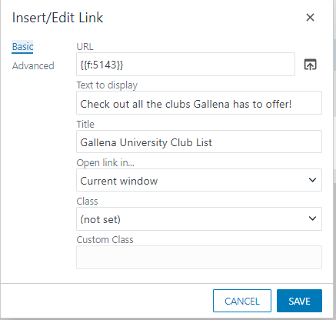
EDITING TOOLS – DEPENDENCY MANAGER
Every page and file in Omni CMS gets a unique ID number
  “Dependency Tag”
When making links, Omni CMS uses the ID number, not a URL
Links to files get automatically updated when they move or are renamed
Broken links will only come from deleted files

Slide 6

REUSABLE CONTENT
Assets
When you want to reuse content and structure/styling
Not customizable on page
Pages update automatically
Five types:
  Web Content
  Plain Text
  Source Code
  Form
  Image Gallery
Snippets
When you want to reuse structure/styling, but keep content unique
Customizable on page
Changes to one page won’t affect other pages
Makes it easier to edit complex blocks of content in WYSIWYG
Components
When you want to reuse structure/styling, but
keep content unique
Uses form fields to prompt for content
Customize content on each page
Changes to the Component’s base code WILL be reflected across all pages with the Component

Slide 7
Let’s Jump In!

Slide 8
support.moderncampus.com

Slide 9
Our next Monthly Orientation Training
will be held on
Friday, April 8, 2022 @ 10 am - noon PST

Slide 10



















Icons for use
Copy and paste these into your presentation as needed

