Slide 1
Tuesday, March 15, 2022

Slide 2
Exploring and Building Gadgets
Cory Madden, Associate Product Manager

Slide 3
Agenda
Purpose and possibilities
Requirements
Configuration
HTML & JavaScript
Gadget library tools
Additional API possibilities

Slide 4
Purpose
What is a gadget?
Full application
Self encapsulated
Extends the functionality of Omni CMS

Slide 5
Possibilities
What are the limitations?
Exists in an <iframe>
Unable to directly access the main application context
What are the possibilities?
Any self-contained logic/code functionality
Full use of Omni CMS APIs
Full use of Metadata API
Interaction with main application context via exposed methods in gadget library

Slide 6
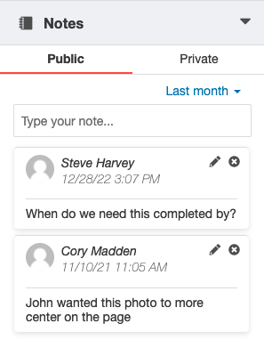
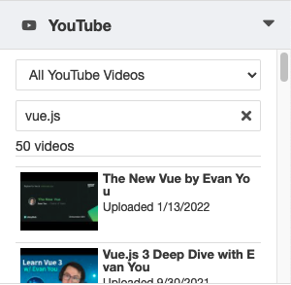
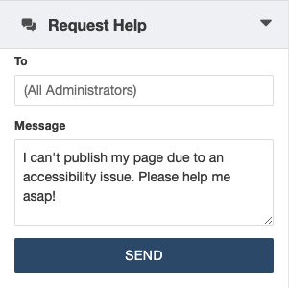
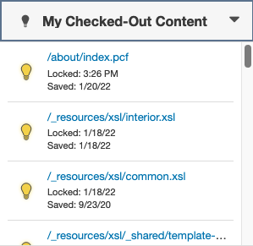
Examples

Slide 7
Requirements
Library Files
gadgetlib.js or gadgetlib.min.js
jQuery
Gadget Files
config.xml
index.html
Access files with a web browser
Publish them through Omni CMS!

Slide 8
Gadget Files
config.xml
Must be XML valid
Allows you to specify gadget configurations
This MUST exist as Omni CMS needs to read it
index.html
Main application file
Includes the HTML, CSS, and JavaScript for the gadget

Slide 9
config.xml
<entry key=“option”>value</entry>
Title
Icon
Description
Thumbnail
Types
Sidebar Context
Notifications
Initial Height

Slide 10
index.html
Standard HTML document and structure
May include
Stylesheet references
Third party JavaScript
Must include jQuery for gadgetlib.js to function
Must include gadgetlib.js for token handling and loading

Slide 11
gadgetlib.js
All API calls from gadgets require access tokens & environment details
GadgetLib is a JavaScript library that handles the following:
Handles environment details
Sets up access token (deactivates after 30 minutes of inactivity)
Provides global “gadget” object as an API to interact with Omni CMS
Provides methods to use the Metadata API

Slide 12
gadgetlib.js methods
ready
The gadget can communicate with Omni CMS
oucGetCurrentFileInfo
Returns relevant information about the containing file
oucInsertAtCursor
Inserts content at the cursor location in, and only in, the WYSWIYG or Source Code Editor
oucGetCurrentLocation
Returns the app window’s location info
oucSetCurrentLocation
Sets the app route, everything after the “siteName”
#cms/accountName/siteName/browse/staging/about

Slide 13
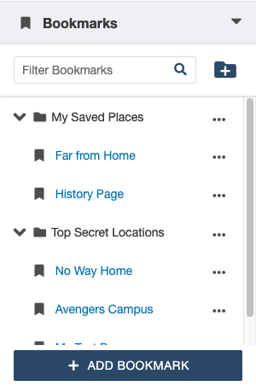
gadgetlib.js Metadata API
Two system gadgets utilize these methods for storing persistent data on the CMS.
Create
View
Update
Delete
List

Slide 14
Let’s Dive In!

Slide 15
Additional Resources
Gadget Starter
https://github.com/omniupdate/gadget-starter
Omni CMS APIs
https://developers.omniupdate.com/

Slide 16
Thank you!

