Slide 1
Tuesday, March 15, 2022

Slide 2
The Magic of Metadata API
Cory Madden, Associate Product Manager

Slide 3
Agenda
What is the metadata API?
Methods of metadata
Where can it be used?
Further documentation

Slide 4
What is the Metadata API?
Document-based database
Creates persistent data
Uses JSON to store the data
Free-form content structure
YOU create schema with identifier
YOU consume the schema
Can be any JSON structure
Can be anything YOU consider is important!

Slide 5
Basic Functions of Metadata
Has the standard CRUD operations
List
View
Create
Update
Delete
Has some Update/Delete operations for multiple metadata entries
Update
Delete

Slide 6
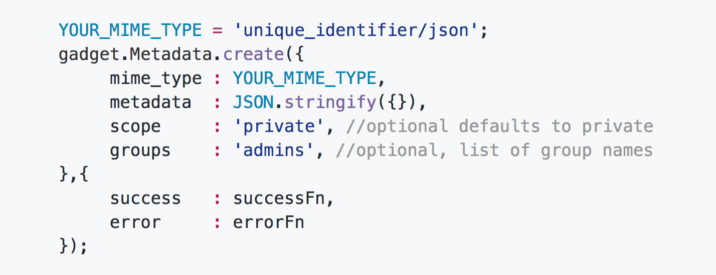
Metadata API Call Example
/metadata/new endpoint via gadgetlib.js

Slide 7
Advanced Functions of Metadata
Linking creates a relationship between metadata and a CMS data model.
Linking should be always be called after the ID is returned from a /new call, or else the metadata will be "orphaned", and only visible via mime type lookups (List/View calls without the ”item” parameter).
Asset
Page
Directory/Folder
Site
Group
Unlinking
As you may have guessed, removes this relationship.

Slide 8
Linking Example
Link your metadata with a “link_type”

Slide 9
Where can it be used?
Primary use is for your custom gadgets!
Can share data between multiple gadgets
Two Omni CMS system gadgets use the metadata API

Slide 10
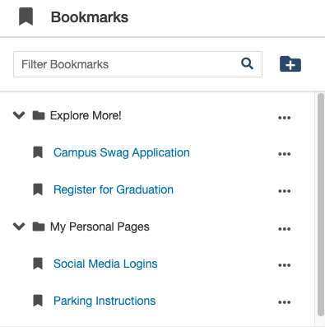
Bookmark Gadget
Allows users to bookmark specific product locations for fast access.
The JSON schema is grouped by folder by front end display.
Utilizes the basic functions (CRUD) of metadata API

Slide 11
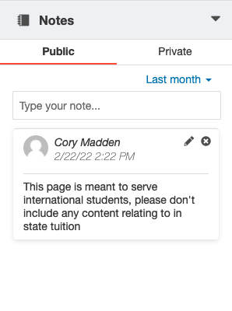
Notes Gadget
Allows a user to write a note about a given file or asset.
Can be a public or private note
Utilizes the linking function of the metadata API

Slide 12
Further Documentation
https://developers.omniupdate.com
Sidebar Link to “Metadata”
https://github.com/omniupdate/gadget-starter
Contains methods that will make your custom gadget easier to make!

Slide 13
Thank you!

