Slide 2
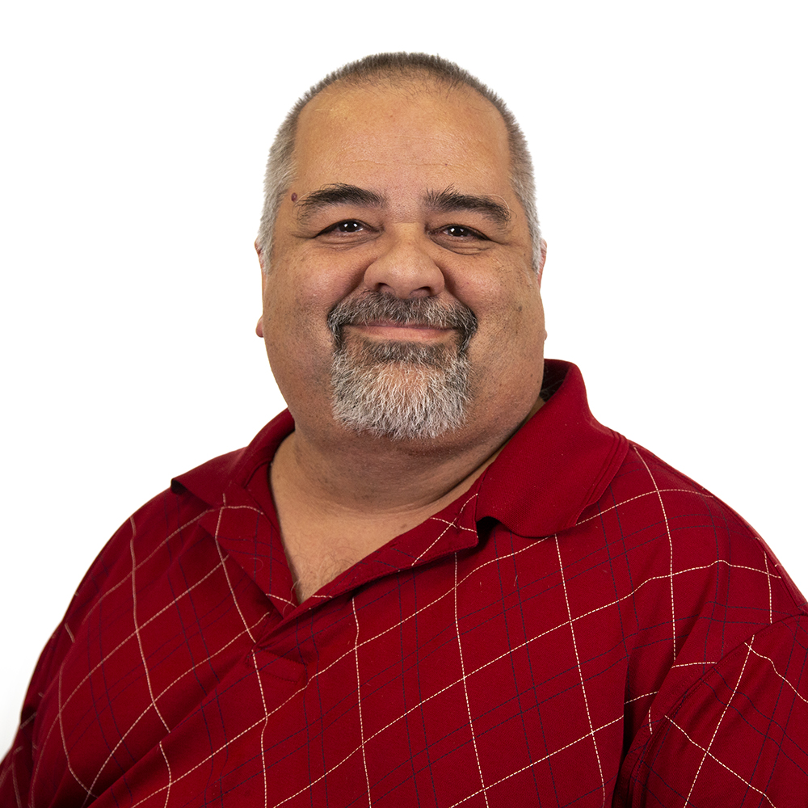
Supporting Your Team with Documentation
Billy G. Woody II
Training Team Lead Omni CMS
Modern Campus
Custom Support Documents For Your Unique Design

Slide 3
Agenda
Planning
Developing
Implementation

Slide 4
Planning
What roles in Omni CMS do you want to target for training?
Who will be filling those roles?

Slide 5
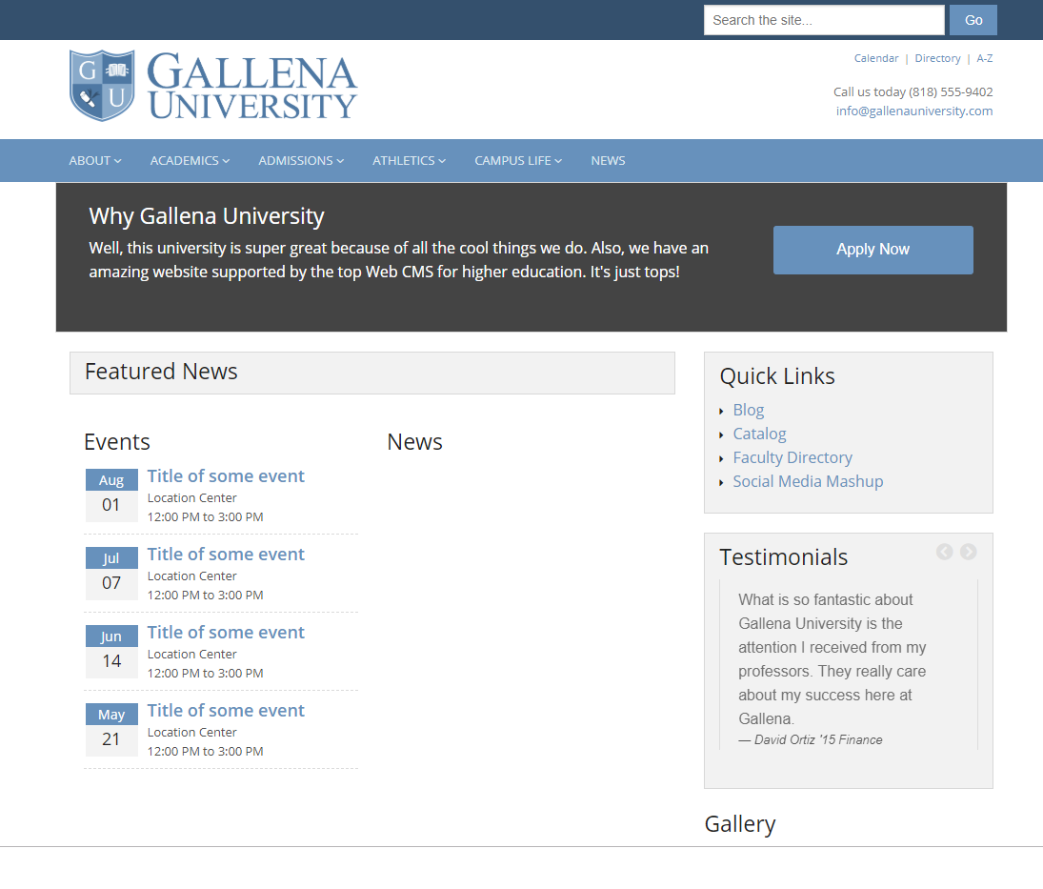
Gallena University - Workflow

Slide 6



Workflow
How Many Different Roles are Needed
Content Editor
Content Approver
Accessibility Approver
Admin Approver

Slide 7
Workflow – Your Turn
How Many Different Roles are Needed
Write down your existing workflow if you have one
Else, jot down what an ideal workflow may be for your institution

Slide 8
Workflow
How Many Different Roles are Needed
& Advanced Content Editor
Content Editor
Content Approver
Accessibility Approver
Admin Approver
Advanced Content Editor

Slide 9
Workflow – Who
Who is filling these roles?
Content Editor
Advanced Content Editor
Content Approvers
Accessibility Approvers
Admin Approvers

Slide 10
Workflow – Who
Who is filling these roles?
Content Editor
(Students, office assistants)
Advanced Content Editor
(Graduate students, professors)
Content Approvers
(Faculty, Deans, Department heads)
Accessibility Approvers
Faculty with training in accessibility
Admin Approvers
IT Specialist

Slide 11
Developing the Roles

Slide 12
Developing the Roles
Content Editor
Logging in to the system
Navigating
Edit existing content
Edit the side nav
Adding new pages
Adding images or video to a page
Adding links
Renaming or deleting pages
Recycling page
Submitting pages for approval

Slide 13
Developing the Roles
Adv. Content Editor
Everything a Content Editor can do
Create and Edit Assets
Create and Edit Components
Build LDP Forms
Build LDP Galleries
Edit the Dictionary

Slide 14
Developing the Roles
Content Approver
Review pages for approval
Approve and submit pages
Decline and return pages for editing
Revert pages to previous versions
Make simple edits to a page

Slide 15
Developing the Roles
Accessibility Approver
Review pages for accessibility issues
Know differences between known, likely, and potential problems
Create and edit exceptions
Decline and return pages
Fixing potential problems
Forward java script concerns to admins
Reverting Pages

Slide 16
Developing the Roles
Admin Approver
Publish Pages
Decline and Revert pages
Add or Edit users
Remove users
Unlock users
Change Passwords

Slide 17
Implementing
Supportive web pages
Videos
Tutorials
PDF Files
Add On Short cuts
Help Request form

Slide 18
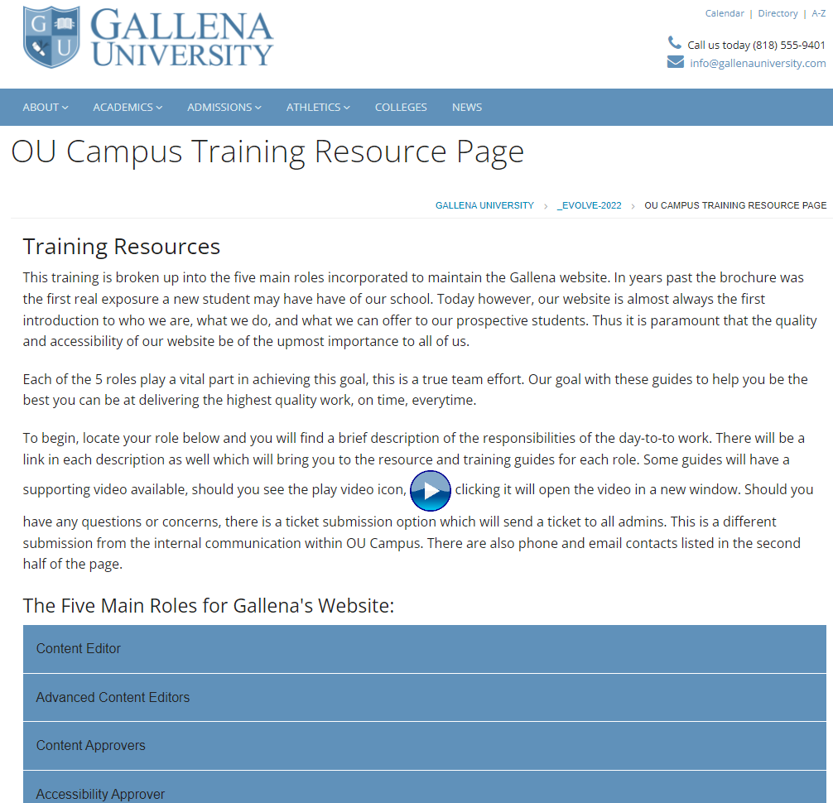

Slide 19
Thank You!

Slide 20



















Icons for use
Copy and paste these into your presentation as needed

