Slide 1
The Ins and Outs of Tailwind CSS for Melody
TM
Caleb Hardin

Slide 2
Frames
Tiles
Notes:
-Melody is Omni CMS’s next-gen drag-and-drop interface for creating layouts
-Layouts are made from Tiles and Frames. They’re just blocks of HTML

Slide 3
Notes:
-Tailwind is a CSS framework that can be used inside Tiles and Frames

Slide 4
Is
Is not
Utility-based CSS framework
Easy to use
Configurable
Extensible
Component-based toolkit
Require specific HTML structure
Include JavaScript
<p class=“text-xl text-white”>…</p>
<p class=“big-white-text”>…</p>
Notes:
-Let’s see what Tailwind is and isn’t

Slide 5
Benefits
Easier to create HTML blocks
More maintainable CSS
No switching between CSS & HTML
Designing from a predefined system
Portability

Slide 6
Let’s dive in
Notes:
Demo

Slide 7
The following slides are provided for download use

Slide 8
Tile name: Full Width Split Image
Notes:
-This tile can be edited in your sites by copying the “Full Width Split Image” tile
-We’re going to look through this tile’s source

Slide 9
Insert slides with demo info for download use
Tailwind classes
Notes:
First let’s take a closer look at its contents

Slide 10
Insert slides with demo info for download use
padding-left and padding-right

Slide 11
Insert slides with demo info for download use
width: 100%;

Slide 12
Insert slides with demo info for download use
position: relative;

Slide 13
Insert slides with demo info for download use
Responsive classes

Slide 14
Insert slides with demo info for download use
width: 50%; (only on large screens)

Slide 15
Insert slides with demo info for download use
padding-left: 0px; padding-right: 0px; (only on large screens)

Slide 16
Insert slides with demo info for download use
Inline styles should be used sparingly and only when the
size needed is not included in Tailwind (see default sizing)

Slide 17
Insert slides with demo info for download use
Lots of styles for a button,
let’s see another option

Slide 18
Navigate to the Custom CSS section of styles

Slide 19
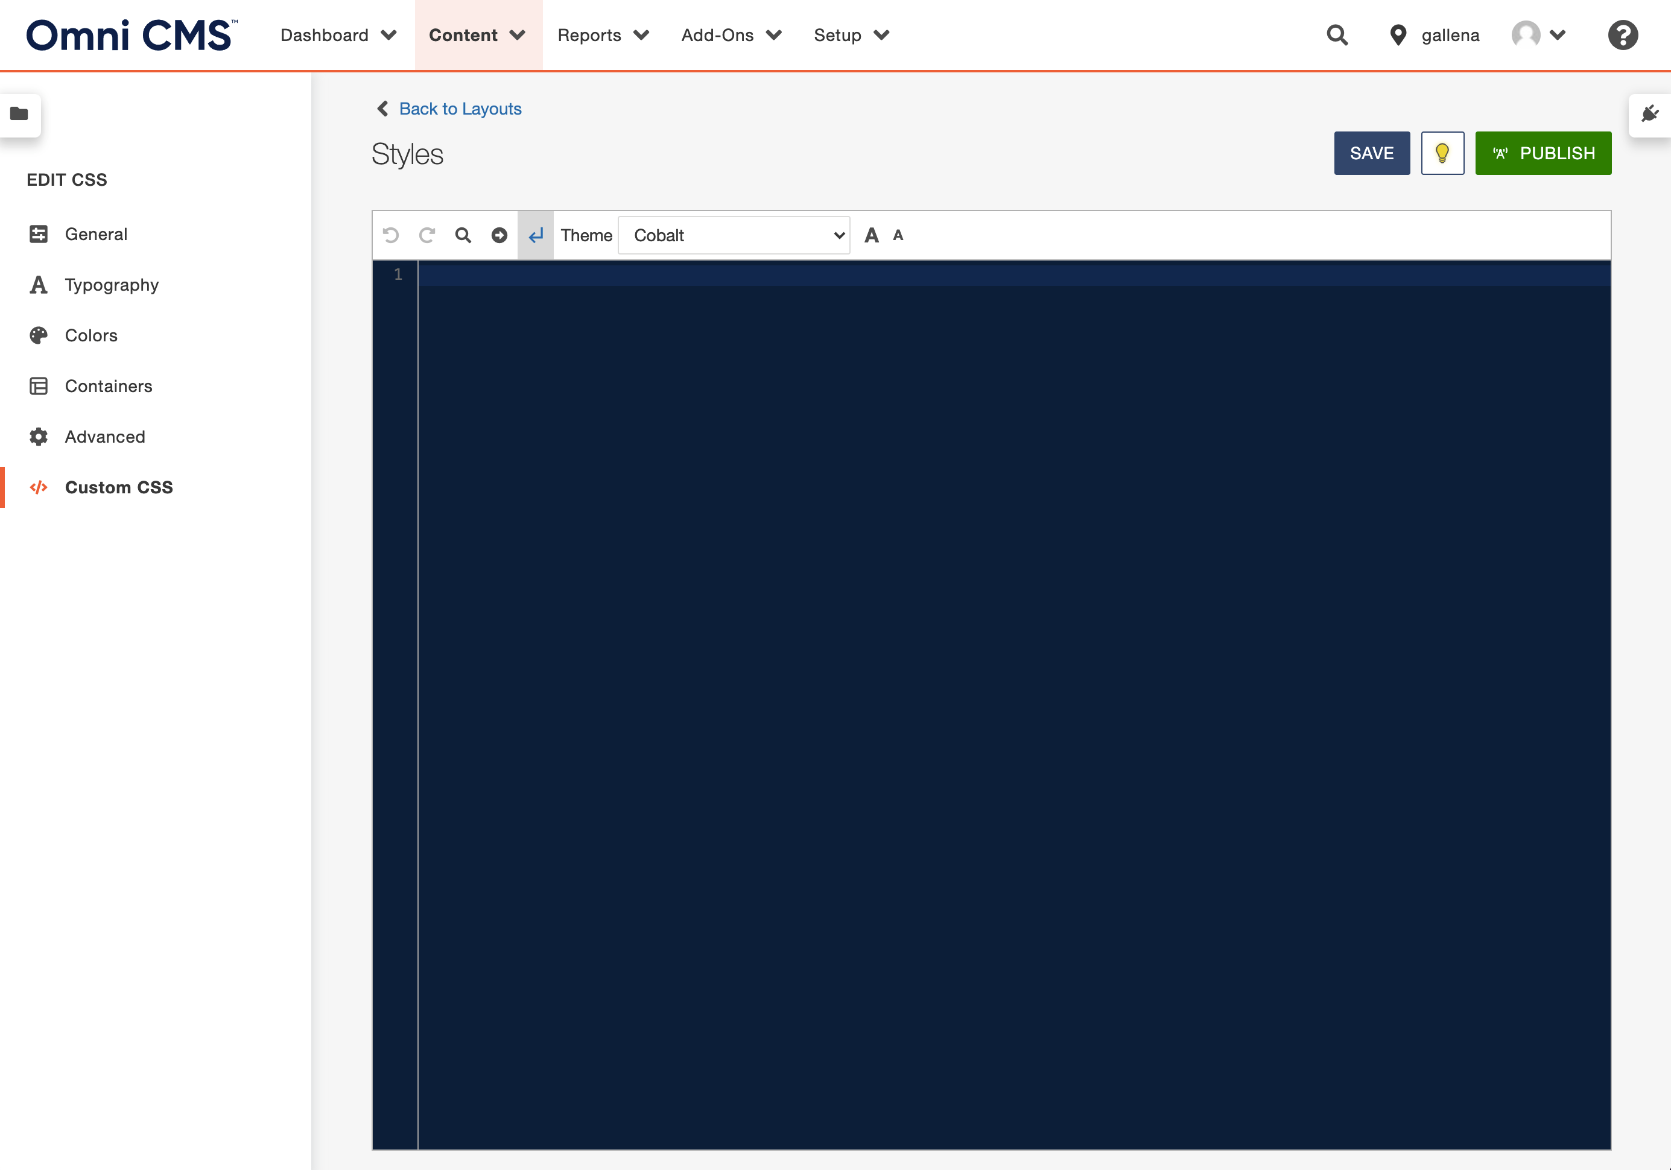
Navigate to the Custom CSS section of styles
Custom styles can be added here

Slide 20
Navigate to the Custom CSS section of styles
Custom styles can be added here

Slide 21
A closer look…
Define a new class

Slide 22
A closer look…
List all the same class names

Slide 23
All styles from the listed classes will be applied to .btn
A closer look…
Use the @apply directive

Slide 24
Insert slides with demo info for download use
Back to the tile
Replace these classes with .btn

Slide 25
One class for all styles

