Slide 1
Wednesday, March 16, 2022

Slide 2

Creating Reusable Sections in Melody
Alok Somani – Principal Software Developer – Omni CMS

Slide 3
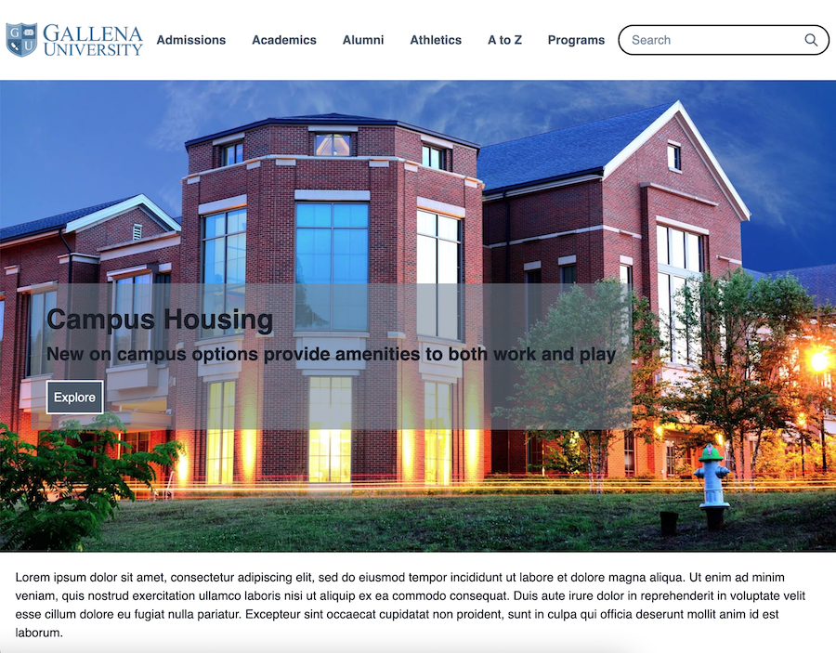
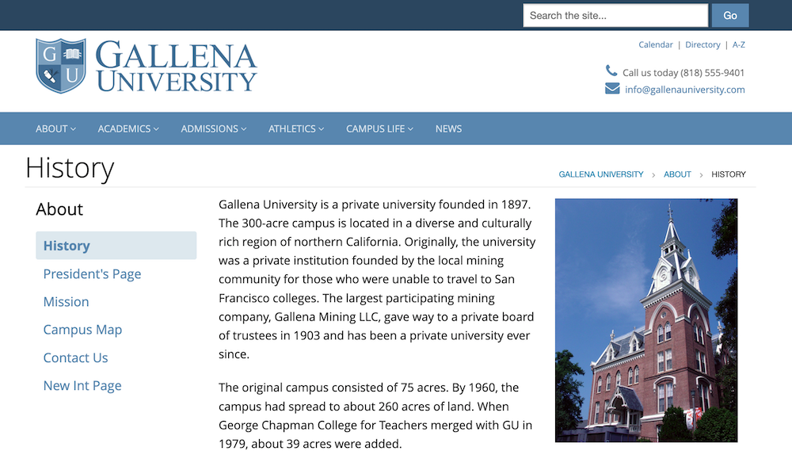
The Goal of a CMS
To provide an easy way to create and manage all of the content for your website
Notes:
- The simplistic goal of a CMS is to enable you to build a website

Slide 4
What is Melody?
Simplified content creation reimagined from the ground up
What were our goals?
  Ease of use
  Reusability
  Flexibility
  Workflow Management
Focused on the tools of the modern web: HTML, CSS, and JavaScript
Notes:
Melody is what we envisioned when we took away what we knew about how CMS systems CURRENTLY function and started to think about how CMS systems SHOULD function.
The goal in its simplest form was to make creating content as easy as possible, while also:
Still offering the flexibility that creators need
Still offering the workflow management that universities with complex teams, like yours, need
Our first major decision was to focus on and enable the tools of the modern web that developers and creators are most familiar with: HTML, CSS, and JavaScript
While XSL offers a ton of power and flexibility, it’s not something that all users need all the time. That power still exists in our CMS and Melody is not built to detract from that.

Slide 5
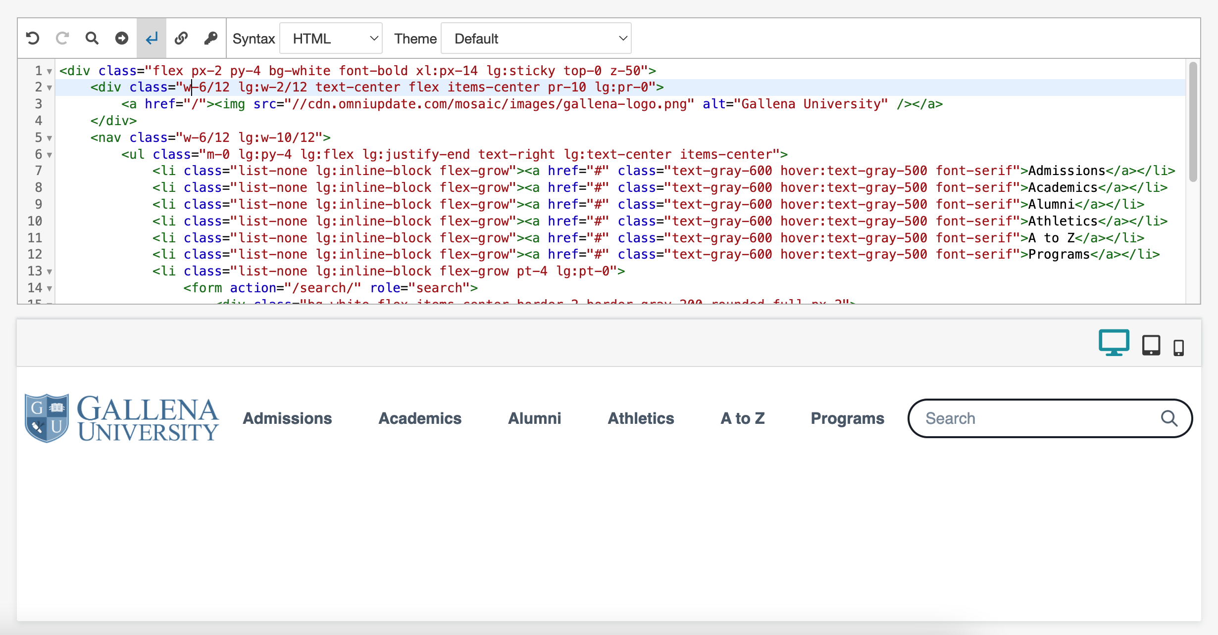
HTML
Source Code Editor
Live Preview
Notes:
To create the HTML for reusable sections, we leveraged the Source Code editor with its built in syntax highlighting, autocompletion, and other features
We have worked on and included a live preview on the same page as the editor so you can see the output of your HTML

Slide 6
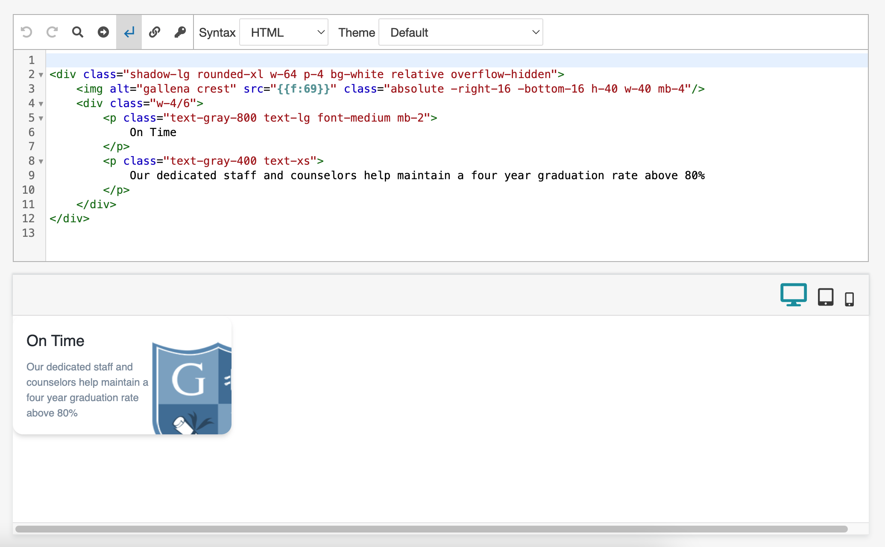
CSS: Tailwind
Utility class driven CSS framework
What does that mean?
Notes:
We wanted to give you as much of a head start and customization flexibility as we could when factoring in how to manage your CSS
There is no requirement to deal with or pull in multiple CSS files
Tailwind.css is a utility class based approach rather than an opinionated framework. What do I mean by that?
That means that I don’t have to write my HTML in a prescribed way because the CSS framework says so
It means that I don’t actually have to write any CSS at all for most things; there is a class or combination of classes to achieve just about anything I want

Slide 7
JavaScript
Head code of Layout
Pull in JS libraries
Write custom scripts
Automatically gets added to the <head> of created pages on Publish
Notes:
Knowing that there would be a need to be able to pull in JavaScript libraries, write custom scripts, and even make other modifications in the page head code, we exposed an editor on the Layout side of things to be able to do this
Everything that you define for the Layout Headcode will automatically get added to the Page when the page is created
All of it will end up in the <head> element of the Published page

Slide 8
Terminology
Tile
Frame
Layout
Page (LCF)
Notes:
We have used some of these words already, but we should be clear about what each represents:
A Tile is the building block for the puzzle that is Melody
In a Tile, you define the HTML and CSS classes for that given section
A Frame is a special type of tile that lets you place containers on a Layout to help create rules about where Tiles can go. I.e., the column/grid/structure of the page
You can put multiple Frames and Tiles in whatever arrangement you like on a Layout, which serves as your template
A Page (with the LCF extension) is the resulting file that gets created in the CMS when you create a New Page from a Layout, and at least in the product, works very similarly to a PCF file

Slide 9

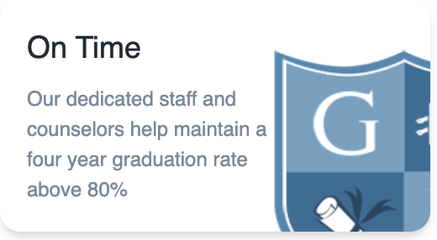


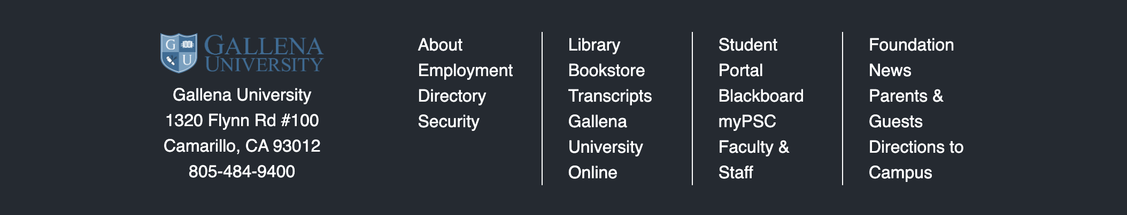
Tile Examples
Notes:
Here are some examples of some of the types of Tiles you can create in Melody to make building your pages easy

Slide 10
Additional Resources
Tailwind CSS Documentation
Tailwind Components:
Tailwindcomponents.com
LofiUI
MerakiUI
…and plenty more!
Notes:
One of the biggest benefits of using industry standards like HTML and Utility driven CSS is portability.
You can go on the web and find tons of examples of sections built using nothing but plain HTML and Tailwind CSS, and you can create a Tile from that pretty much wholesale
You can even use the HTML from non-Tailwind components and use the Tailwind equivalent classes
I’ll show an example of this during this presentation

Slide 11
Thank You!

