Slide 2

Editing Pages with Accessibility in Mind
Billy G. Woody II
Training Team Lead Omni CMS
Modern Campus
Accessibility and Omni CMS

Slide 3
Agenda
Accessibility Overview
Designing for Web Accessibility
Using Insights to score pages for accessibility

Slide 4
What is Accessibility
“Strategies, standards, and supporting resources to help make the Web more accessible to people with disabilities so that they may perceive, understand, navigate, and interact with and contribute to the Web.”
– Web Accessibility Initiative

Slide 5
Web Accessibility Encompasses:
auditory
cognitive
neurological
physical
speech
visual

Slide 6
Web Accessibility Also Encompasses:
Cell phones, Smart watches, Smart TVs
Tablets
Other small screen devices
Older people with changing abilities due to ageing
People with “temporary disabilities” such as a broken arm or lost glasses
People with “situational limitations” such as in bright sunlight or in an environment where they cannot listen to audio
People using a slow Internet connection, or who have limited or expensive bandwidth

Slide 7
Web Content Accessibility Guideline (WCAG)
WCAG is a set of guidelines developed by the Accessibility Guidelines Working Group which is part of the W3C, the World Wide Web Consortium.
Current standard is WCAG 2.1, came out in June 2018
The newest version, WCAG 2.2, is due to be introduced in June ’22
  https://www.w3.org/TR/WCAG22/

Slide 8
WCAG comes in three levels of conformance
A
  Some impact on design
AA
  Medium impact on design
AAA
  High / extreme impact on design

Slide 9
Level A
Level A is a subset of Level AA. There are 25 criteria that you must meet to reach Level A.

Slide 10
Level AA
To reach Level AA you must meet 13 more criteria in addition to the 25 for Level A.

Slide 11
Level AAA
To reach Level AAA you must meet the previous 38 criteria plus an additional 23 more for a total of 61 criteria that must be met.

Slide 12
Conformance Example – Use of Color
A – Color is not the only way to convey information, action, or distinguishing a visual element
AA – The same as Level A but the contrast ratio must be at least 4.5:1
AAA – The same as Level A but with a contrast ratio of at least 7:1

Slide 13
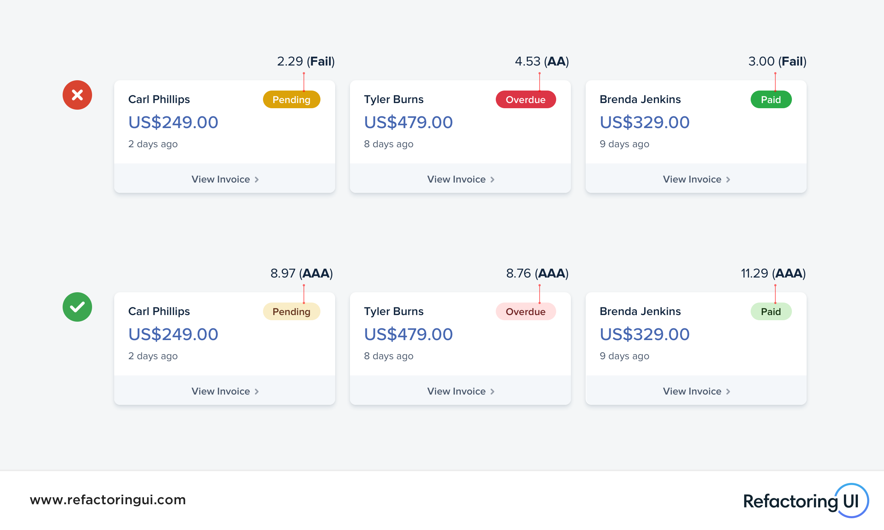

Slide 14
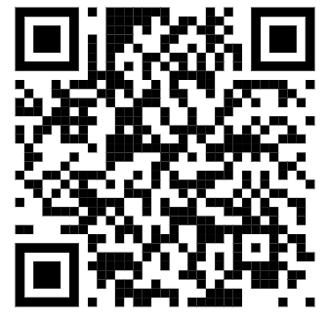
Exercise One
Checking Contrast
WebAIM Contrast Checker
https://webaim.org/resources/contrastchecker/

Slide 15
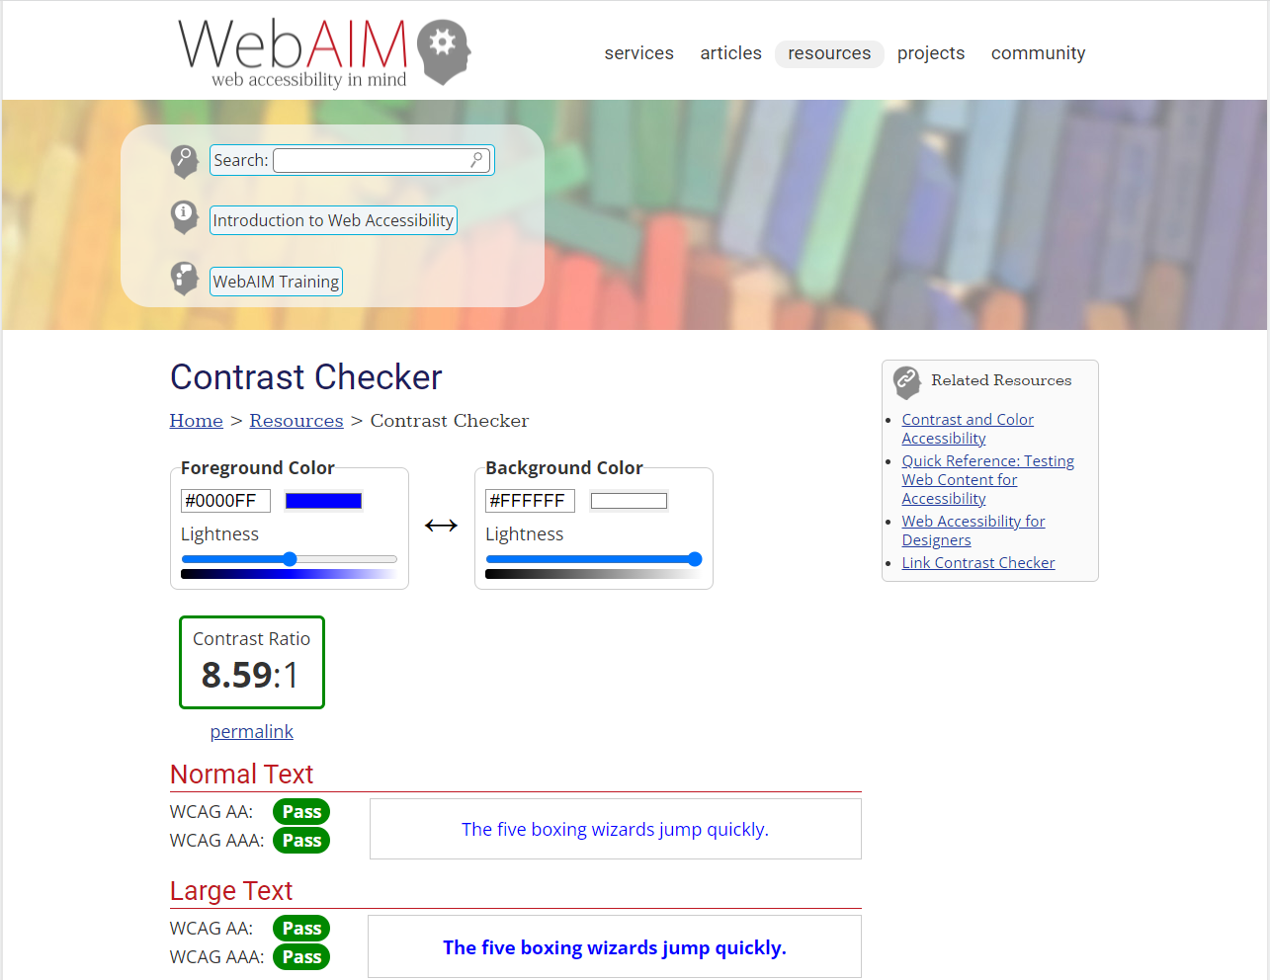

Slide 16
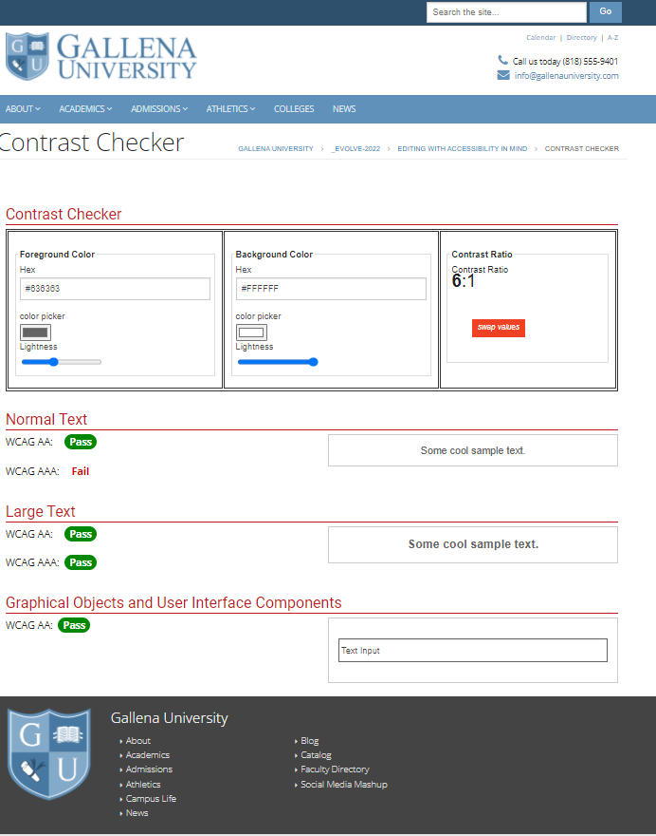
Class Exercise (5 minutes)
Go to the Contrast Checker page I created in Omni
Using some of your existing site colors, test them for contrast ratios. The link can be found in the addons dropdown menu.

Slide 17
Adding Links, Ambiguous Link Text
You want to avoid the “Click Here” of “More Information” verbiage
Your link should be descriptive
  Instead of saying “Click here for the Financial Aid Application”
  Make the text Financial Aid Form the actual link:
    “In order to apply, fill out the Financial Aid Form”

Slide 18
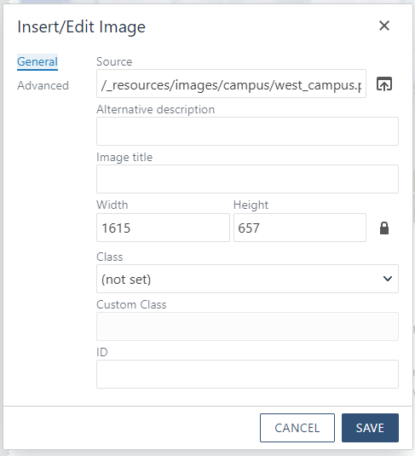
Avoid using ‘Image Title’ on Images
When adding an image to a page, use only the Alt-Text

Slide 19



Avoid Text Within an Image
If an image has text in it and it is expected to be read, the accessibility ready will never read it.
Image of Text
Actual Text

Slide 20
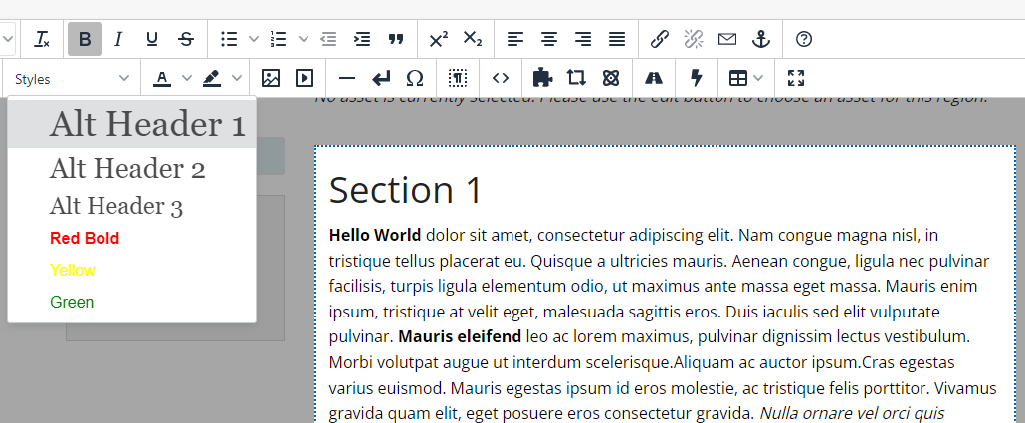
Avoid using Bold to Emphasize Text
Use a pre-defined style or potentially an H-tag if needed

Slide 21
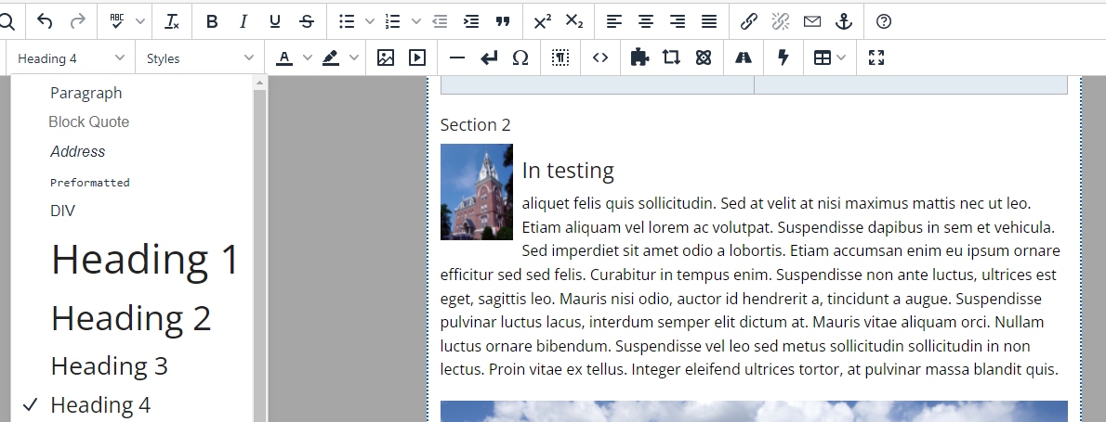
Avoid using H-Tags Emphasize Text
If the emphasized text is not a new section, do not use an H-Tag

Slide 22
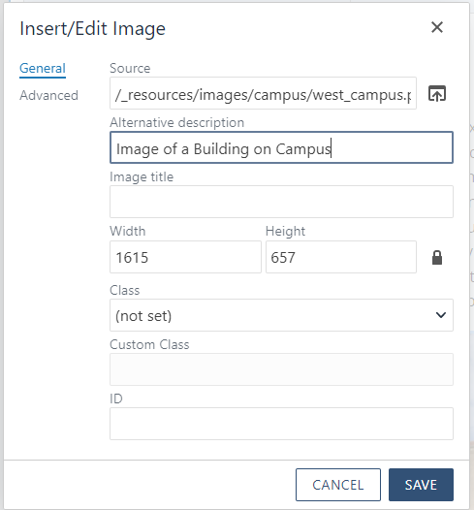
Avoid “Image” or “Picture” in Alt-Text
Since the accessibility reader will state that it is an image, it will redundantly call it an image again from the alt-text

Slide 23
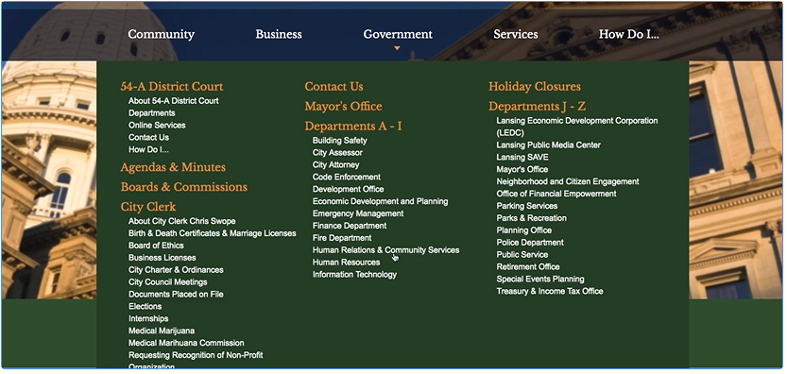
Too Many Navigation Links
Screen Readers must read through each navigation link, so if there are 50 links in your navigation, it can take a long time to traverse a site.

Slide 24
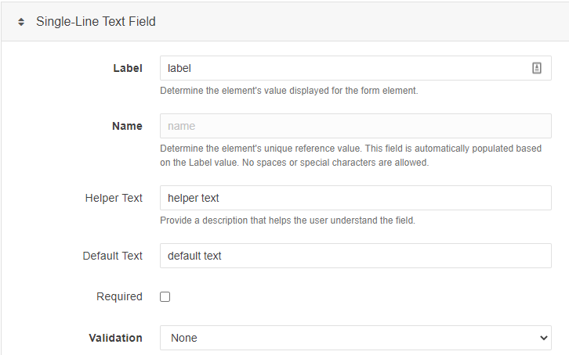
Empty or Default Form Labels
When building forms in Omni CMS, make sure that you have unique form labels for each field. Do not leave the default text.

Slide 25
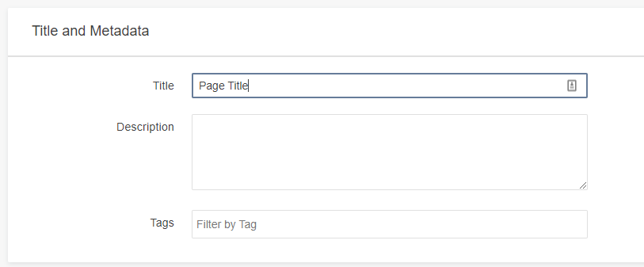
Use Unique Page Titles
An accessibility reader will typically read the title of a page first from the <title> tag. Leaving this as “Page Title” does not aid in accessibility.

Slide 26

Omni Insights
Insights is a module that reports on search engine optimization (SEO) strength, accessibility compliance, spelling, and links for an Omni CMS site.

Slide 27
Omni Insights
Because Insights checks your live website and not the staging server, Insights can scan pages that aren't managed by Omni CMS.

Slide 28
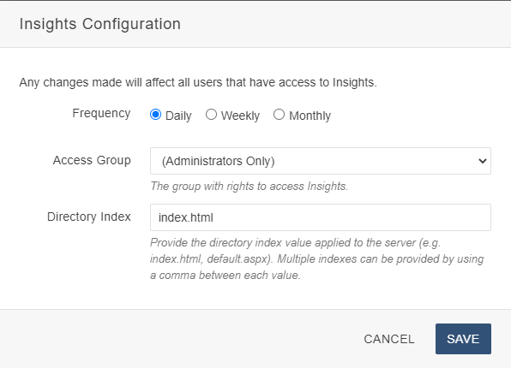
Omni Insights

Slide 29
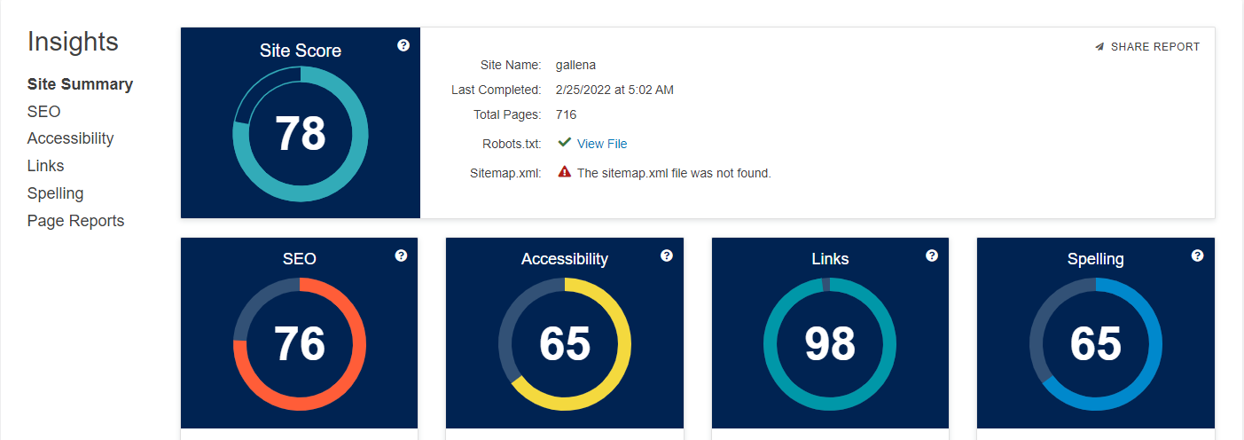
Omni Insights

Slide 30
Accessibility CSS
Create a custom CSS for highlighting Accessibility items on a page
Show where H-tags are being used Quickly
Highlight Broken Links
Show missing alt –text
Show empty table cells
Etc.

Slide 31
Thank You!

Slide 32


















Icons for use
Copy and paste these into your presentation as needed

